Slide 1

FIFA 2018 Team Player Analysis
Team 8
Kritika Sinha Krishna Desai
Varun Bagga Aditi

Slide 2





Business Problem
Current State
Future State
XXX team has shown a decline in their performance and needs to improve their likelihood of winning the upcoming tournament.
The general manager of XXXX has been allocated a stringent budget to recruit the players for the new team.
Based on the budget at hand, he wants to recruit the most suitable player for the different positions in the team.
The club has identified the most suitable player for the different positions in a football team and has been able to make these choices within the allocated budget.
The club has a dream team which has increased their likelihood of winning the upcoming tournament and generate higher revenues for the club
Proposed Solution
Identify the best player for the different team roles using the player attributes and ratings captured through historical data.
The model also provides insights into the wages of these players.

Slide 3
Data Description
Data Source: https://www.kaggle.com/thec03u5/fifa-18-demo-player-dataset
Data Attributes Synopsis:
Every player featuring in FIFA 18
70+ attributes
Player and Flag Images
Playing Position Data
Attributes based on actual data of the latest EA's FIFA 18 game
Attributes include on all player style statistics like Dribbling, Aggression, GK Skills etc.
Player personal data like Nationality, Photo, Club, Age, Wage, Salary etc.
Number of Data Attributes-75
Number of Records-17981
Number of Data files-1

Slide 4
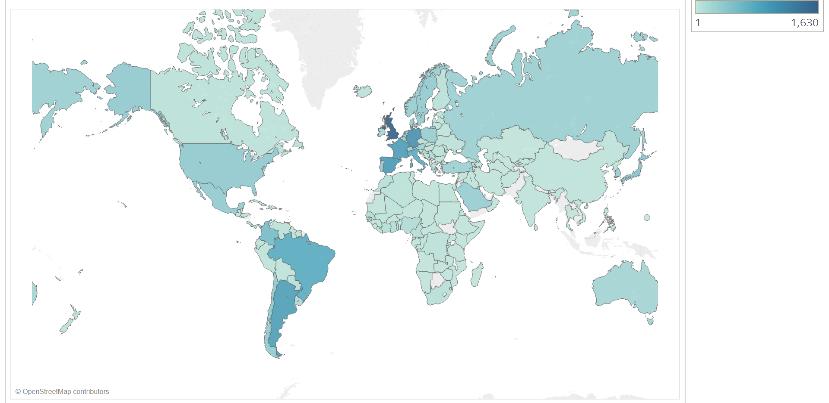
Data Exploration-Top Players per Nationality
England produces the highest number of Football Players that participate in the FIFA Season
England

Slide 5
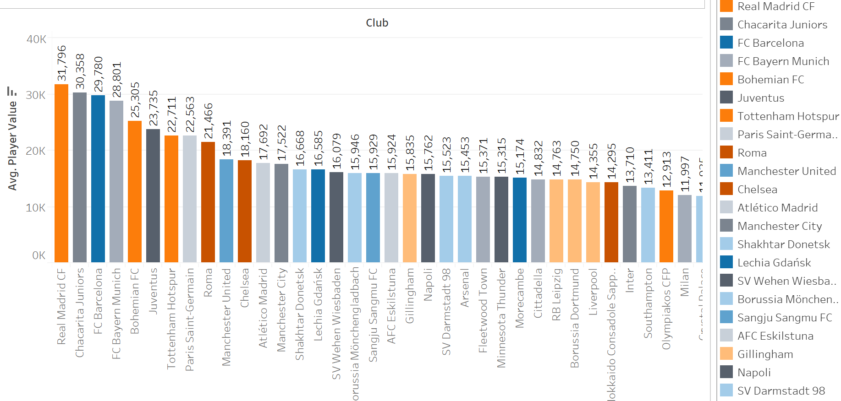
Data Exploration-Average Player Value per Club
Most of the players with high Market Value are part of Real Madrid CF Club

Slide 6
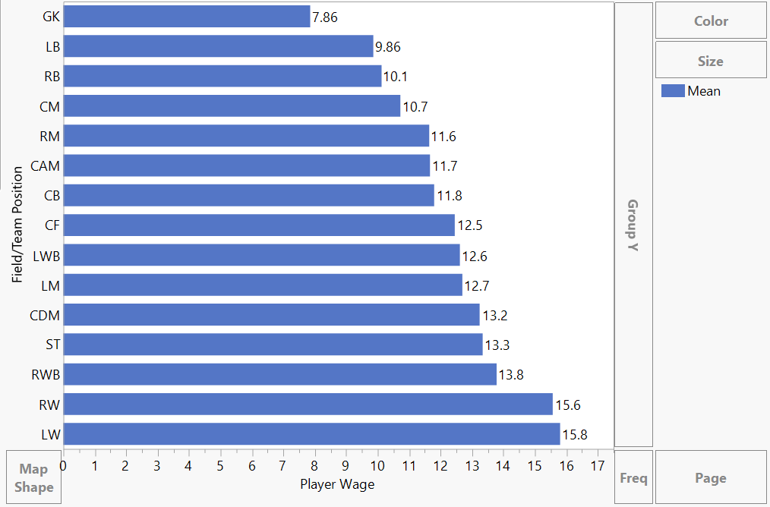
Data Exploration-Player Wage for Different Team Positions
Right Winger and Left Winger Positions are offered the highest salaries in a football team

Slide 7
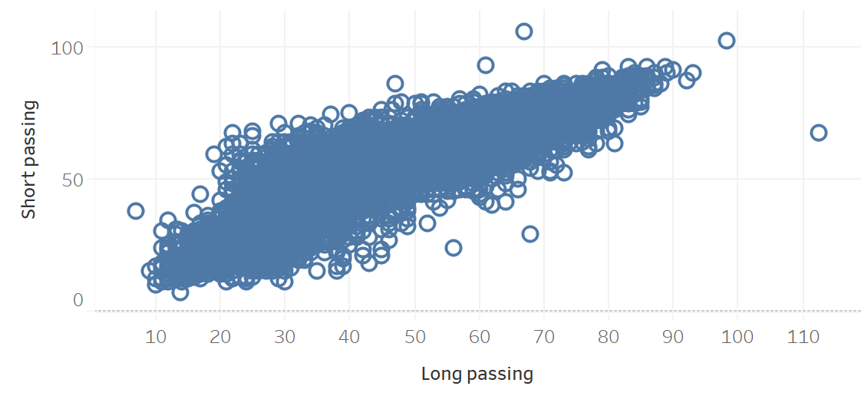
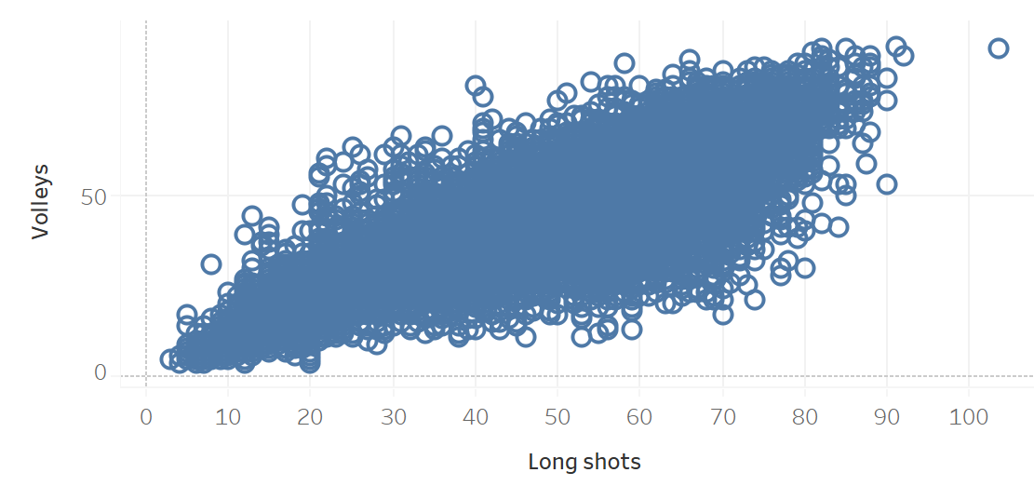
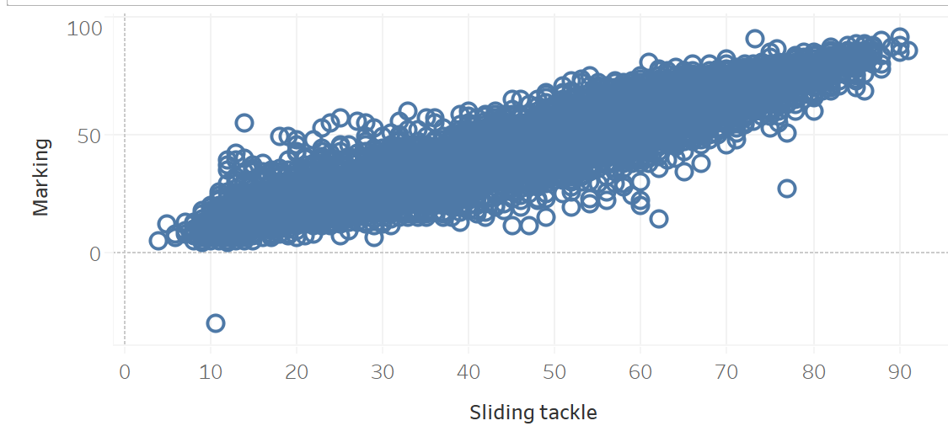
Data Exploration-Player Attribute Relationships
Players who are skilled in Long Passing are also good at short Passing

Slide 8
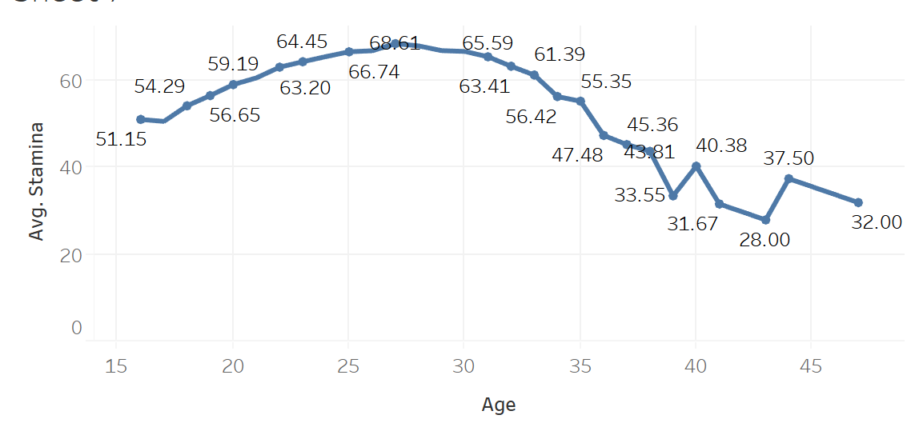
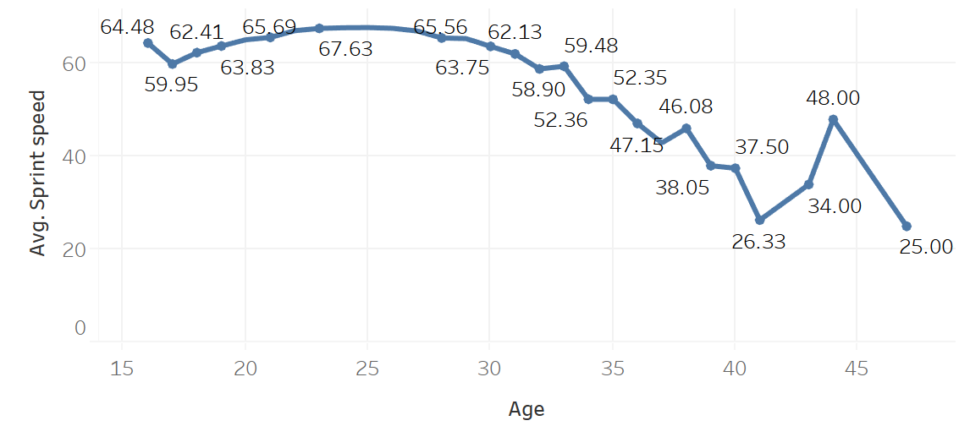
Data Exploration-Player Performance with Age
Average Stamina and Sprint Speed starts decreasing after the age of 30 for most of the football players

Slide 9
Solution Framework-TBD
Data Cleaning
Data Exploration
Variable Selection
Model Testing
Analysis of Results

Slide 10
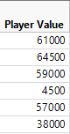
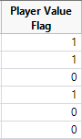
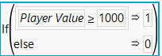
Data Preprocessing
OUTLIER DETECTION & TREATMENT
Player Value , Player Age and Player Salary were treated for outliers
MISSING DATA TREATMENT
Player position attributes were treated for missing values
VARIABLE TRANSFORMATION
Dependent Variable: P
Player Value
(in 1000)
Variable Transformation using condition
Transformed
Variable

Slide 11
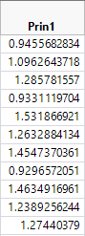
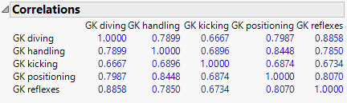
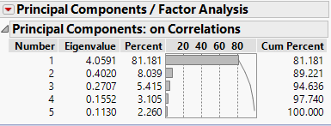
Variable Selection for Model
Multivariate Analysis on Correlations
Other independent variables chosen for the predictive model are:
Acceleration
Age
Aggression
Agility
Balance
Ball Control
Composure
Crossing
Curve
Dribbling
Finishing
Free Kick Accuracy
Heading Accuracy
Interceptions
Jumping
Long Passing
Long Shots
Marking
Penalties
Positioning
Short Passing
Shot Power
Sliding Tackle
Sprint Speed
Stamina
Standing Tackle
Strength
Volleys

Slide 12
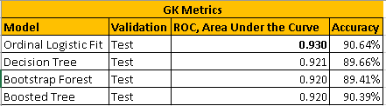
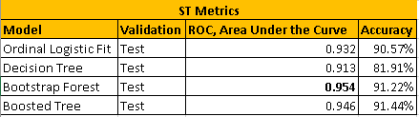
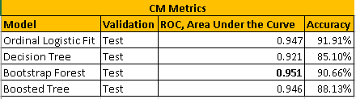
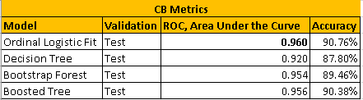
Best Model Predictions for Every Football Field Position
Value Prediction for Goal Keeper
Value Prediction for Striker
Value Prediction for Central Midfielder
Value Prediction for Centre - Back

Slide 13
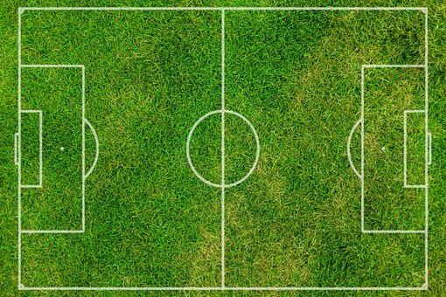

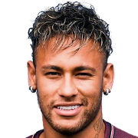

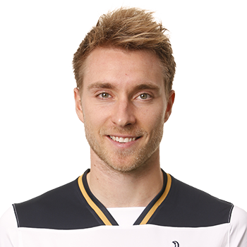
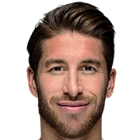
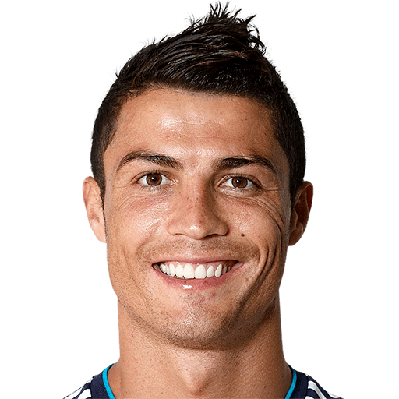
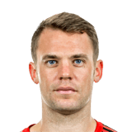
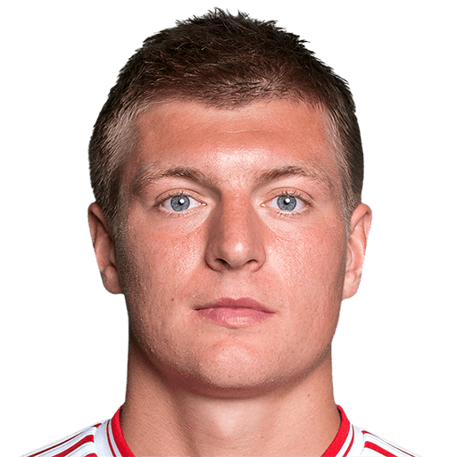

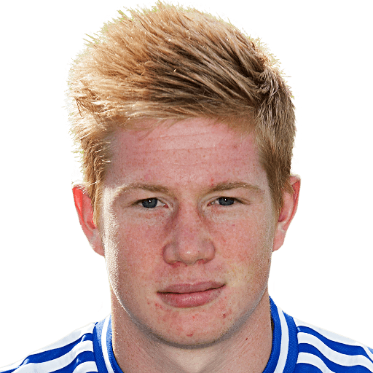

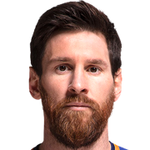
The Ultimate Dream Team!
LB
LW
MARCELO
NEYMAR
LM
ERIKSEN
GK
CB
RAMOS
CM
ST
RONALDO
NEUER
KROOS
CB
CHIELLINI
RM
DE BRUYNE
RB
RW
CARVAJAL
MESSI

Slide 14












Dream Squad worth ??? (in Million Euros)
€ 771.5M
MARCELO
NEYMAR
ERIKSEN
RAMOS
NEUER
KROOS
RONALDO
CHIELLINI
DE BRUYNE
58,714,516,864 INR
6,015,434,262 Yuan
MESSI
CARVAJAL
909,475,060 USD

Slide 15

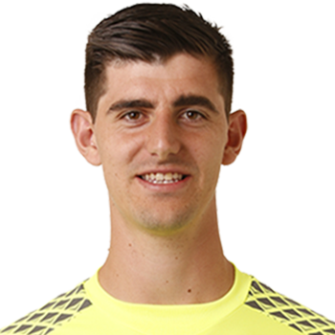
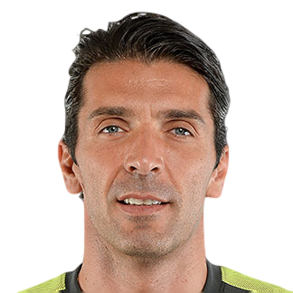


Top 5 Valuable Goal Keepers : Existing Vs Predicted
M. Neuer (#1)
M. Neuer (#1)
De Gea (#2)
De Gea (#2)
T. Courtois (#3)
T. Courtois (#3)
G. Buffon (#4)
J. Oblak (#5)
J. Oblak (#5)
B. Leno (#10)

Slide 16
Top 5 Valuable Goal Keepers : Existing Vs Predicted
M. Neuer (#1)
M. Neuer (#1)
De Gea (#2)
De Gea (#2)
T. Courtois (#3)
T. Courtois (#3)
G. Buffon (#4)
J. Oblak (#5)
J. Oblak (#5)
B. Leno (#10)

Slide 17
Player Attributes: Buffon Vs Leno
Name:
G. Buffon
B. Leno
Age: 39 25
Wage: €110K €61K
Player Significance (Probability):
0.999888198 < 0.99998744
GK Handling: 88 > 84 GK Kicking: 74 = 74 GK Positioning: 90 > 85 GK Reflexes: 84 > 83
Club: Juventus Bayer 04 Leverkusen

Slide 18
Questions!

